Slide 1
SOLAR ENERGY BASICS
Prof. Rahul Suryavanshi
Department of EEE
Gogte Institute of Technology
Belagavi-Karnataka
India

Slide 2
Introduction
The sun radiates energy uniformly in all directions in the form of electromagnetic waves.
The sun is main source of energy for sustainment of life.
It is clean, inexhaustible, abundantly and universally available source.
The major drawback is it is a dilute form of energy.
It is not steady and continuous.
But it is more predictable than wind.
The output of sun is 2.6×10²⁸ kW/Year
The energy reaching the earth is 1.5×10¹⁸ kW/Year.

Slide 3
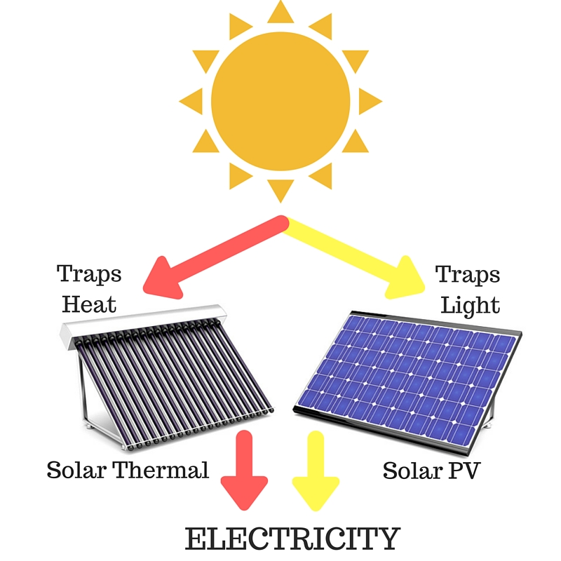
Solar energy can be utilized in two ways:
By collecting the radiant heat and using it in a thermal system.
By collecting and converting it directly to electrical energy using PV system referred as SPV.
Solar energy is the mother of all forms of energy, as various sources of energy find their origin as sun as mentioned below
Wind energy.
Biomass Energy.
Tidal Energy.
Ocean wave energy.
Ocean thermal energy.
Hydro energy

Slide 4

The earliest use of direct solar energy was
1. Warming the body.
2. Drying of clothes.
3. Drying of salt water to get salt.
4. Drying of agriculture products.
All other devices used for harnessing direct solar energy are of fairly recent origin.
Archimedes (212BC), it is said, set the roman fleet on fire by concentrating solar radiation using a large number of small plane mirrors at a distance of several feet from the fleet.
Antoine Lavoisier (1740-1794), achieved temperature upto 1700 degree C by concentrating the sun rays through a magnifying glass.
Solar steam boilers were developed in late 19th century to produce steam to run steam engines. However, after the oil crises 1973, solar energy received renewed interest from mankind.

Slide 5
The Sun as a Source of Energy
The sun, which is largest member of the solar system is a sphere of intensity hot gaseous matter having a diameter of 1.39 million km, and at an average distance of 1.495×10¹¹ m (150.67 million km) from the earth.
As observed from the earth, the sun rotates on its axis about once in every four week.
The equator takes about 27 days and the polar region takes about 30 days for each rotation.

Slide 6
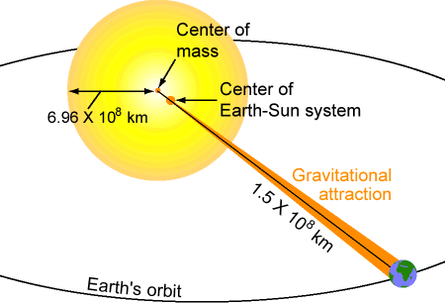
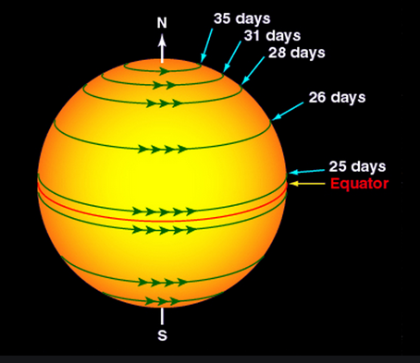

Slide 7
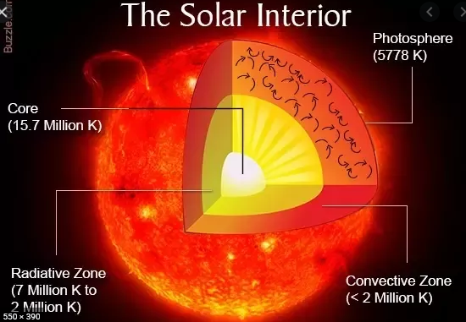
At the inner most region, the core, the temperature is estimated between 8×10⁶ to 40×10⁶ degree K.
The core has a density of about 100 times than that of water and a pressure of 10⁶ atm. (Fusion reaction)
Such a high temp is maintained because of fusion reaction

Slide 8
The most important of them is a reaction in which four hydrogen atoms (proton) combine to form one helium atom. The mass of the helium nucleus is less than that of four protons, the difference of mass having been converted to energy in a fusion reactions as follows:
4(₁H¹) → ₂He⁴ + 26.7 MeV
The surface of the sun is maintained at a temperature of approximately 5800 degree K.

Slide 9
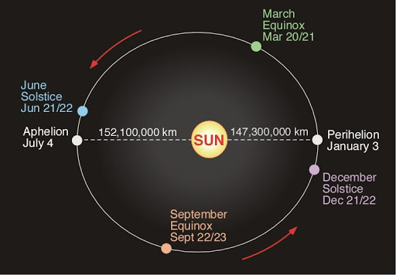
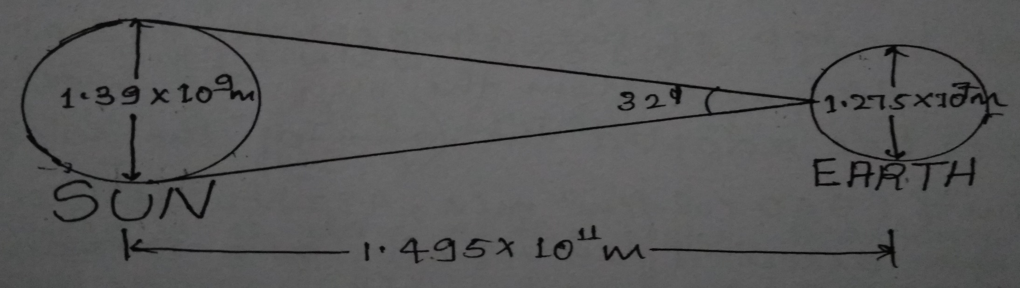
The EARTH (Sun-Earth Relationship)
The earth is shaped as a oblate spheroid a sphere flattened at the poles and bulged in the plane normal to the poles.
For most practical cases earth is considered as a sphere with a diameter of about 1.275*10^7 meters (12,742 km)
The length of days and nights keep changing. The earth reflects about 30% of the sunlight that falls on it. This is known as the earths albedo.
The distance between the sun and the earth varies by 11.7%.
The sun subtends an angle of 0.533 degree and at average sun-earth distance of 1.495×10¹¹m
Also well known as one astronomical unit.

Slide 10
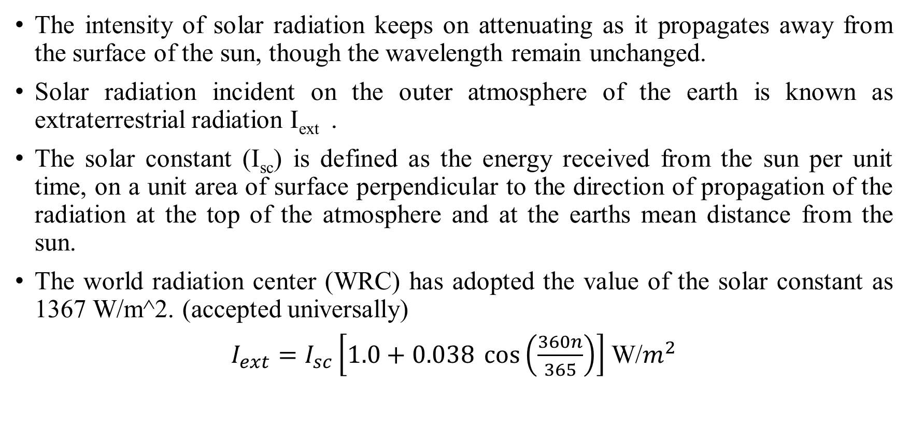
Solar Constant (I_{sc})
The intensity of solar radiation keeps on attenuating as it propagates away from the surface of the sun, though the wavelength remain unchanged.
Solar radiation incident on the outer atmosphere of the earth is known as extraterrestrial radiation I_{ext} .
The solar constant (I_{sc}) is defined as the energy received from the sun per unit time, on a unit area of surface perpendicular to the direction of propagation of the radiation at the top of the atmosphere and at the earths mean distance from the sun.
The world radiation center (WRC) has adopted the value of the solar constant as 1367 W/m^2. (accepted universally)
$I_{ext}=I_{sc}\left[1.0+0.038 \cos\left(\frac{360n}{365}\right)\right]$ W/$m^{2}$

Slide 11
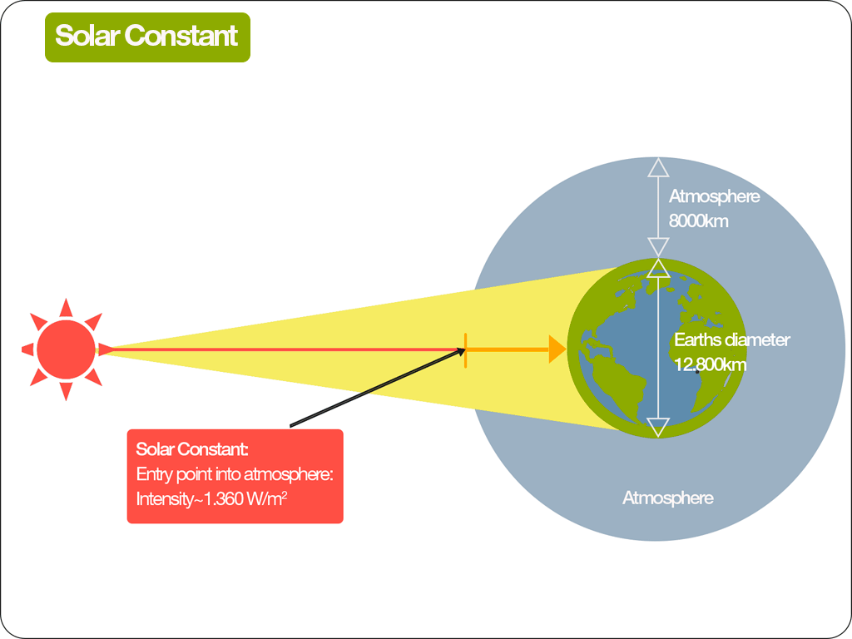

Slide 12
Solar Time: (Local Apparent Time):
Solar time is measured with reference to solar noon, which is the time when the sun is crossing the observers meridian.
At solar noon, the sun is at the higher position in the sky.
The sun traverses each degree of longitude in 4 minutes (as the earth takes 24 hours to complete one revolution).
The standard time is converted to solar time by incorporating two corrections as follows:
Solar time= Standard time ± 4 (L_{st} – L_{loc}) + E
Where, L_{st} = standard longitude used for measuring standard time of the country.
L_{loc} = longitude of the observer’s location
Positive sign is used if the standard meridian of the country lies in the western hemisphere (with reference to the prime meridian)
Negative sign if in eastern hemisphere

Slide 13
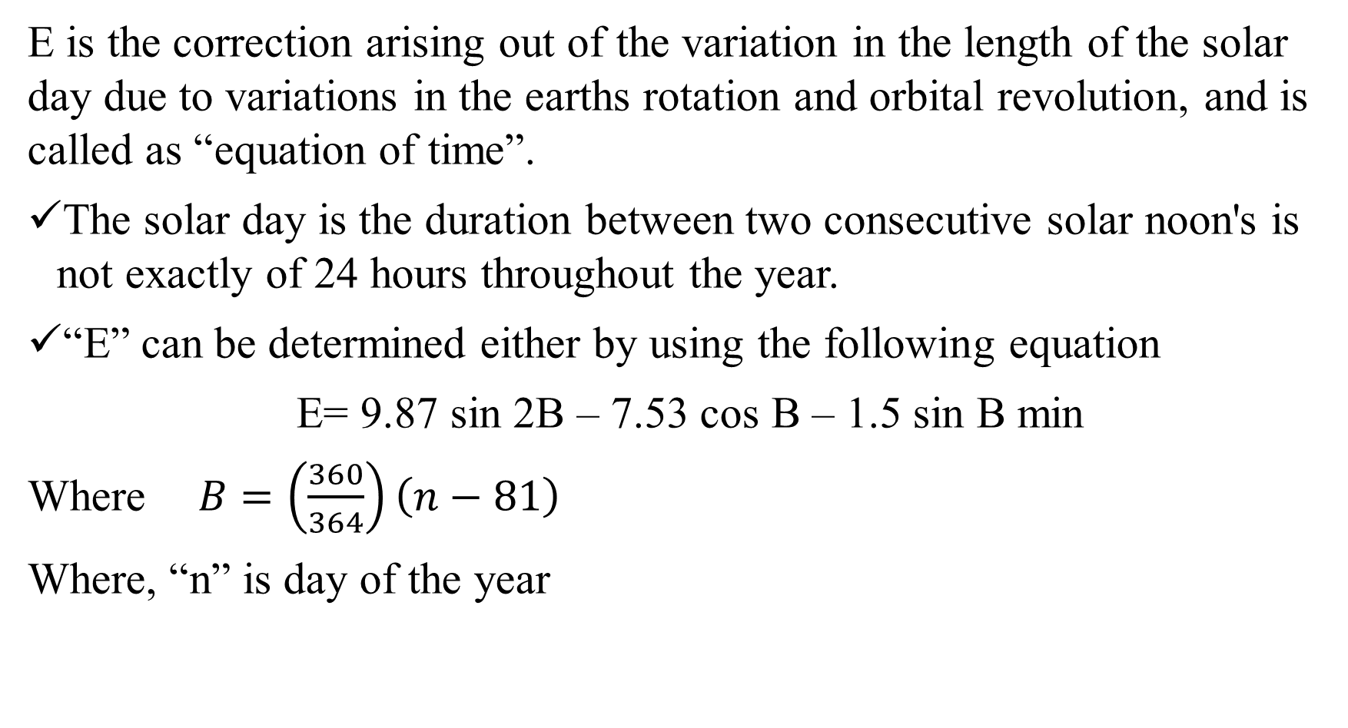
E is the correction arising out of the variation in the length of the solar day due to variations in the earths rotation and orbital revolution, and is called as “equation of time”.
The solar day is the duration between two consecutive solar noon's is not exactly of 24 hours throughout the year.
“E” can be determined either by using the following equation
E= 9.87 sin 2B – 7.53 cos B – 1.5 sin B min
Where $B=\left(\frac{360}{364}\right)\left(n−81\right)$
Where, “n” is day of the year

Slide 14
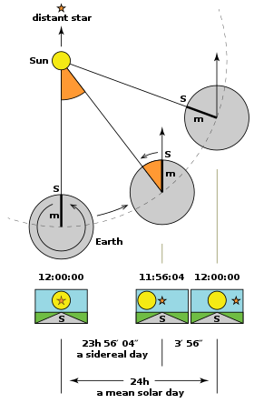
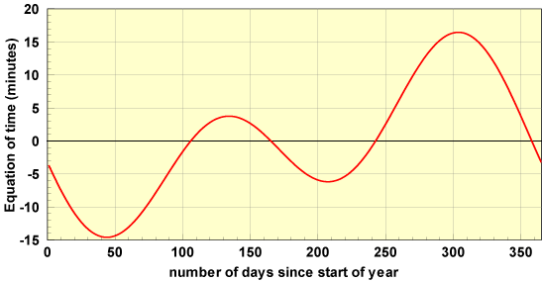

Slide 15
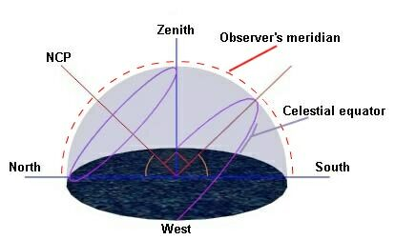
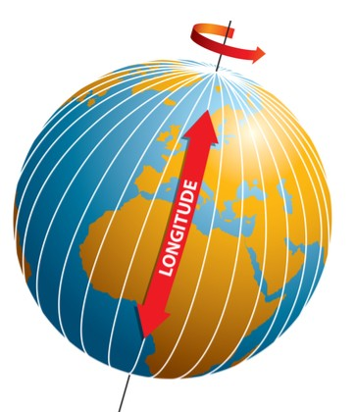
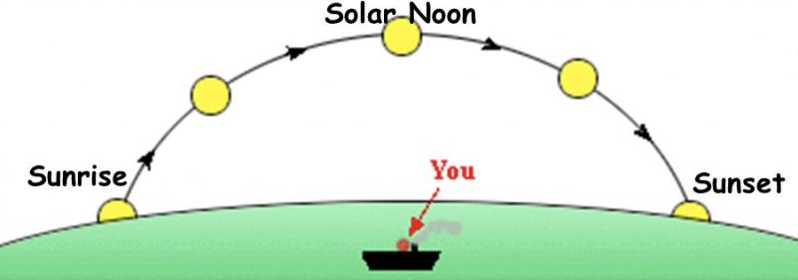

Slide 16
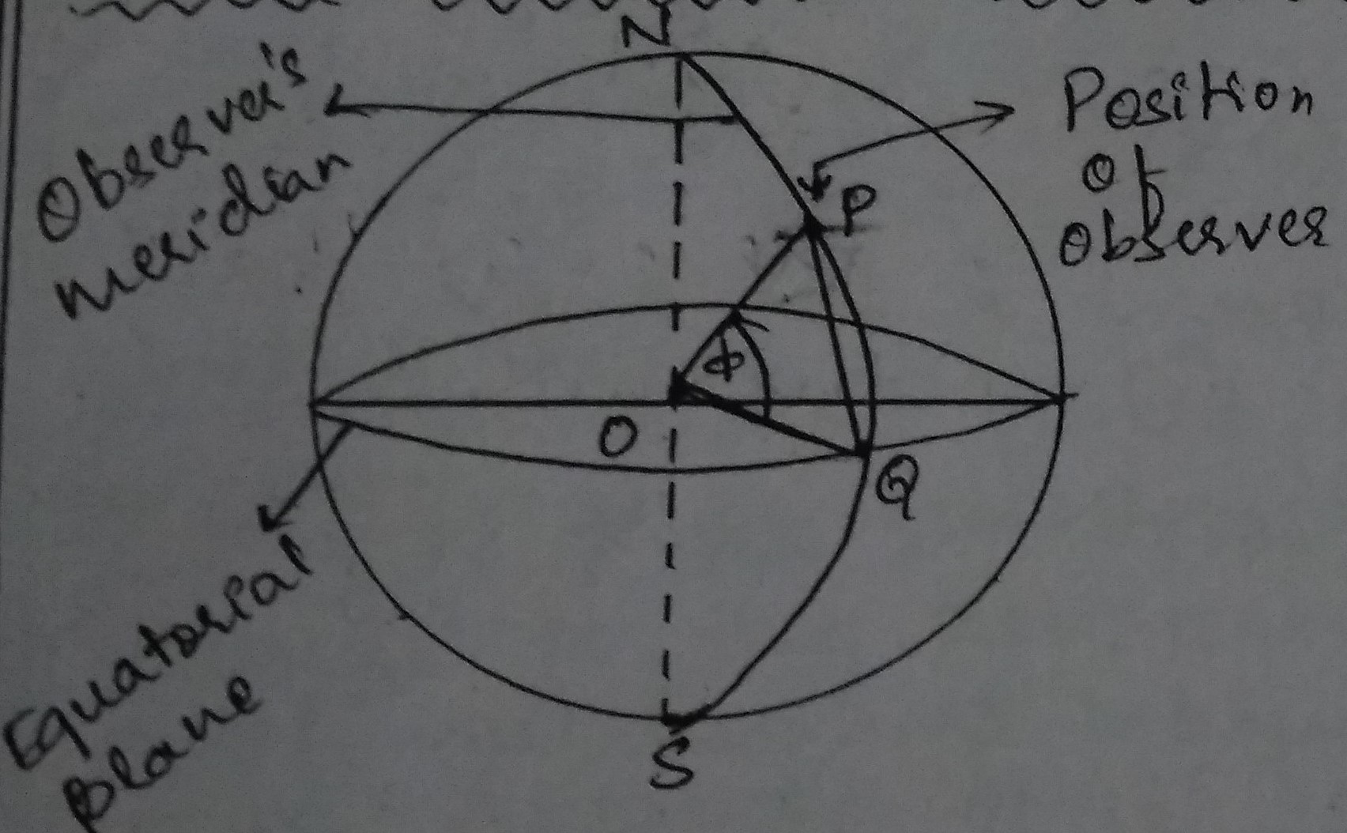
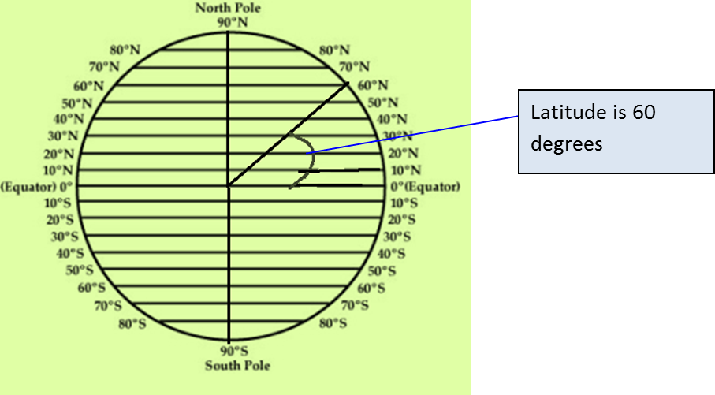
Solar Radiation Geometry
LATITUDE (Angle of Latitude) (ø):
It is the angle made by a radial line joining the given location to the centre of the earth with its projection on the equatorial plane. The latitude is positive for northern hemisphere and negative for southern hemisphere.

Slide 17
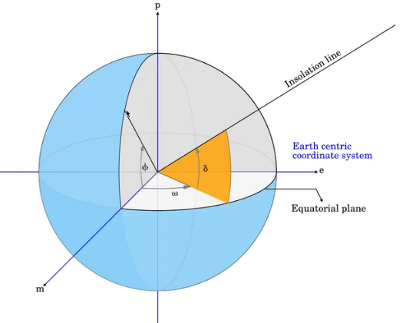
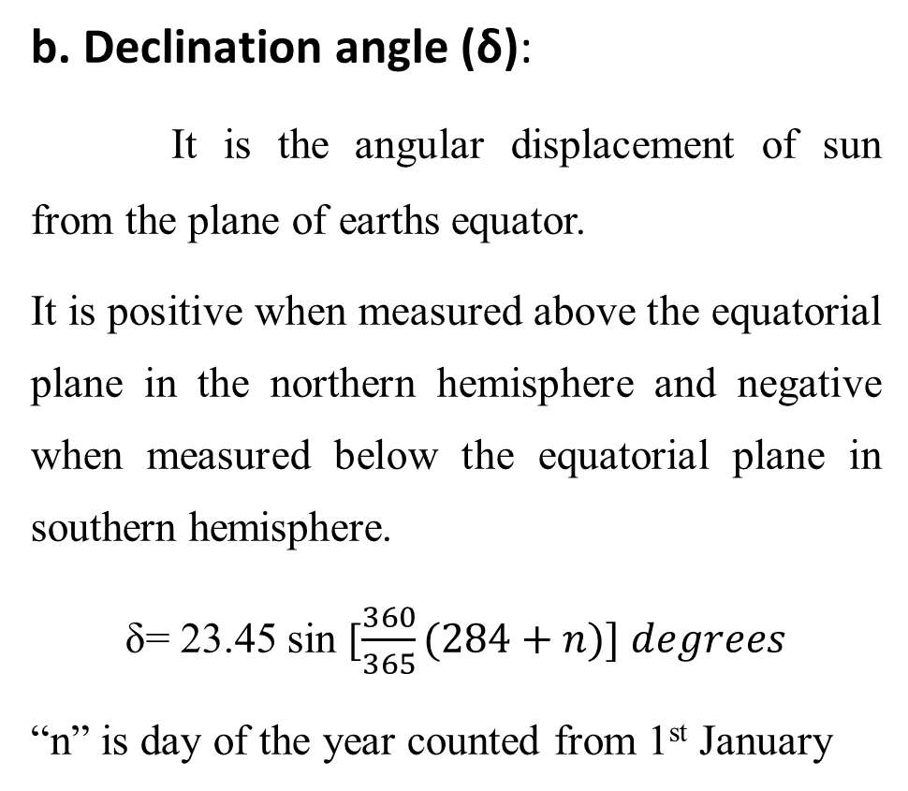
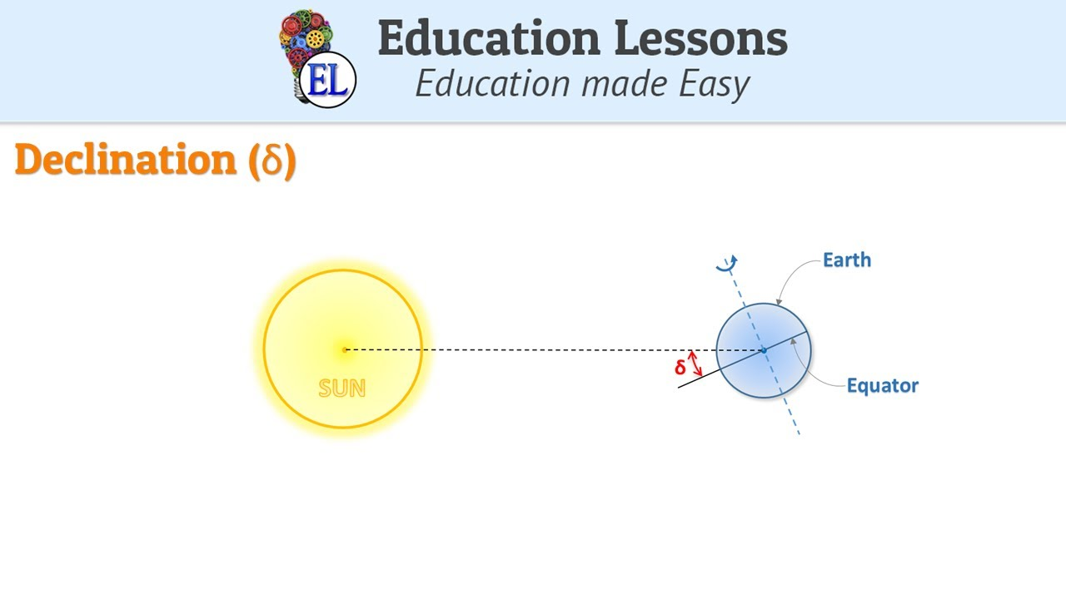
Solar Radiation Geometry

Slide 18
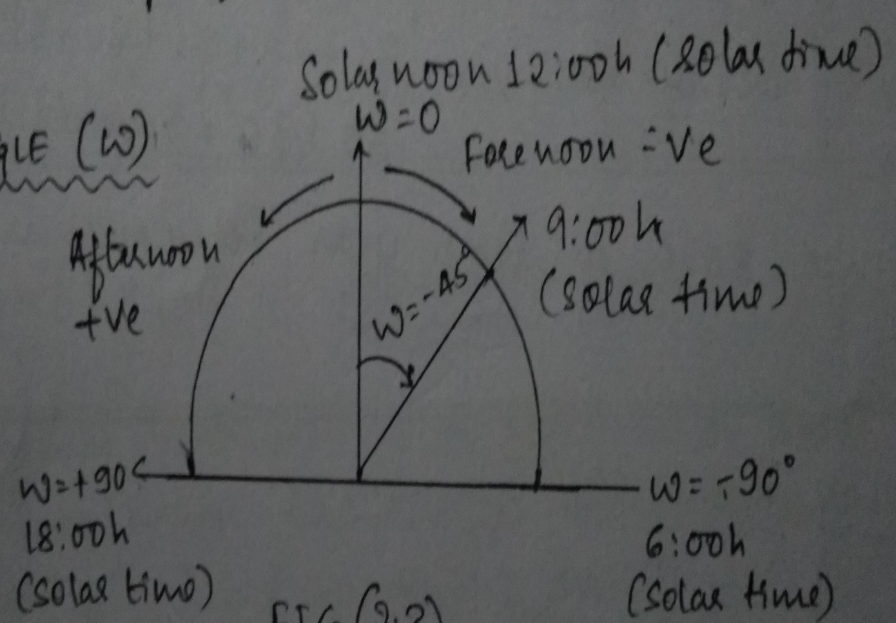
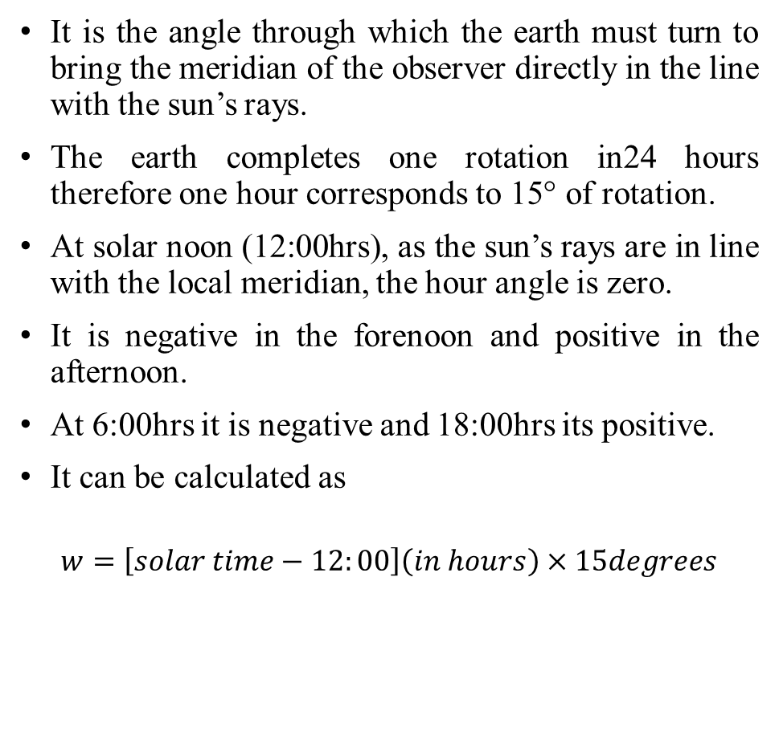
Hour Angle (ω)
It is the angle through which the earth must turn to bring the meridian of the observer directly in the line with the sun’s rays.
The earth completes one rotation in24 hours therefore one hour corresponds to 15° of rotation.
At solar noon (12:00hrs), as the sun’s rays are in line with the local meridian, the hour angle is zero.
It is negative in the forenoon and positive in the afternoon.
At 6:00hrs it is negative and 18:00hrs its positive.
It can be calculated as
$$w=\left[solar time−12:00\right]\left(in hours\right)×15degrees$$

Slide 19
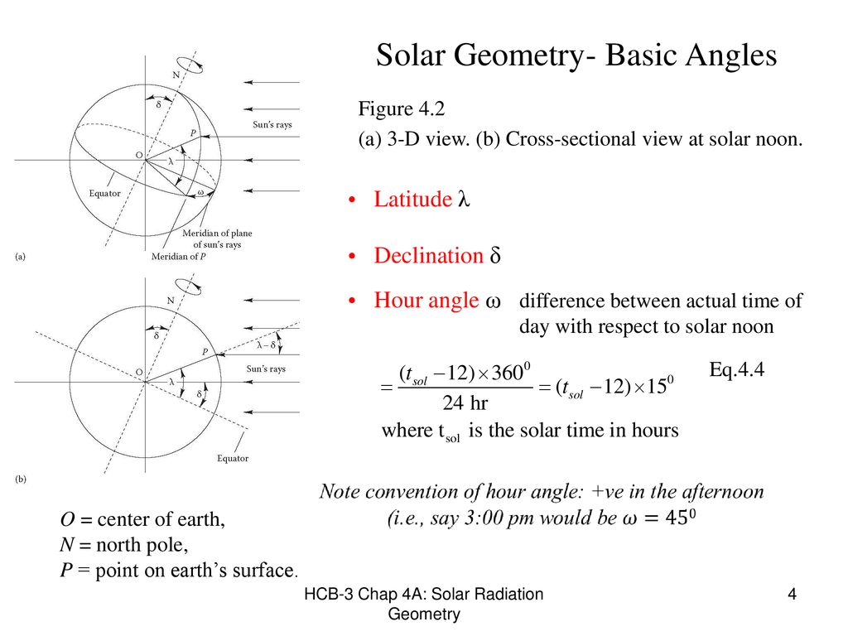

Slide 20
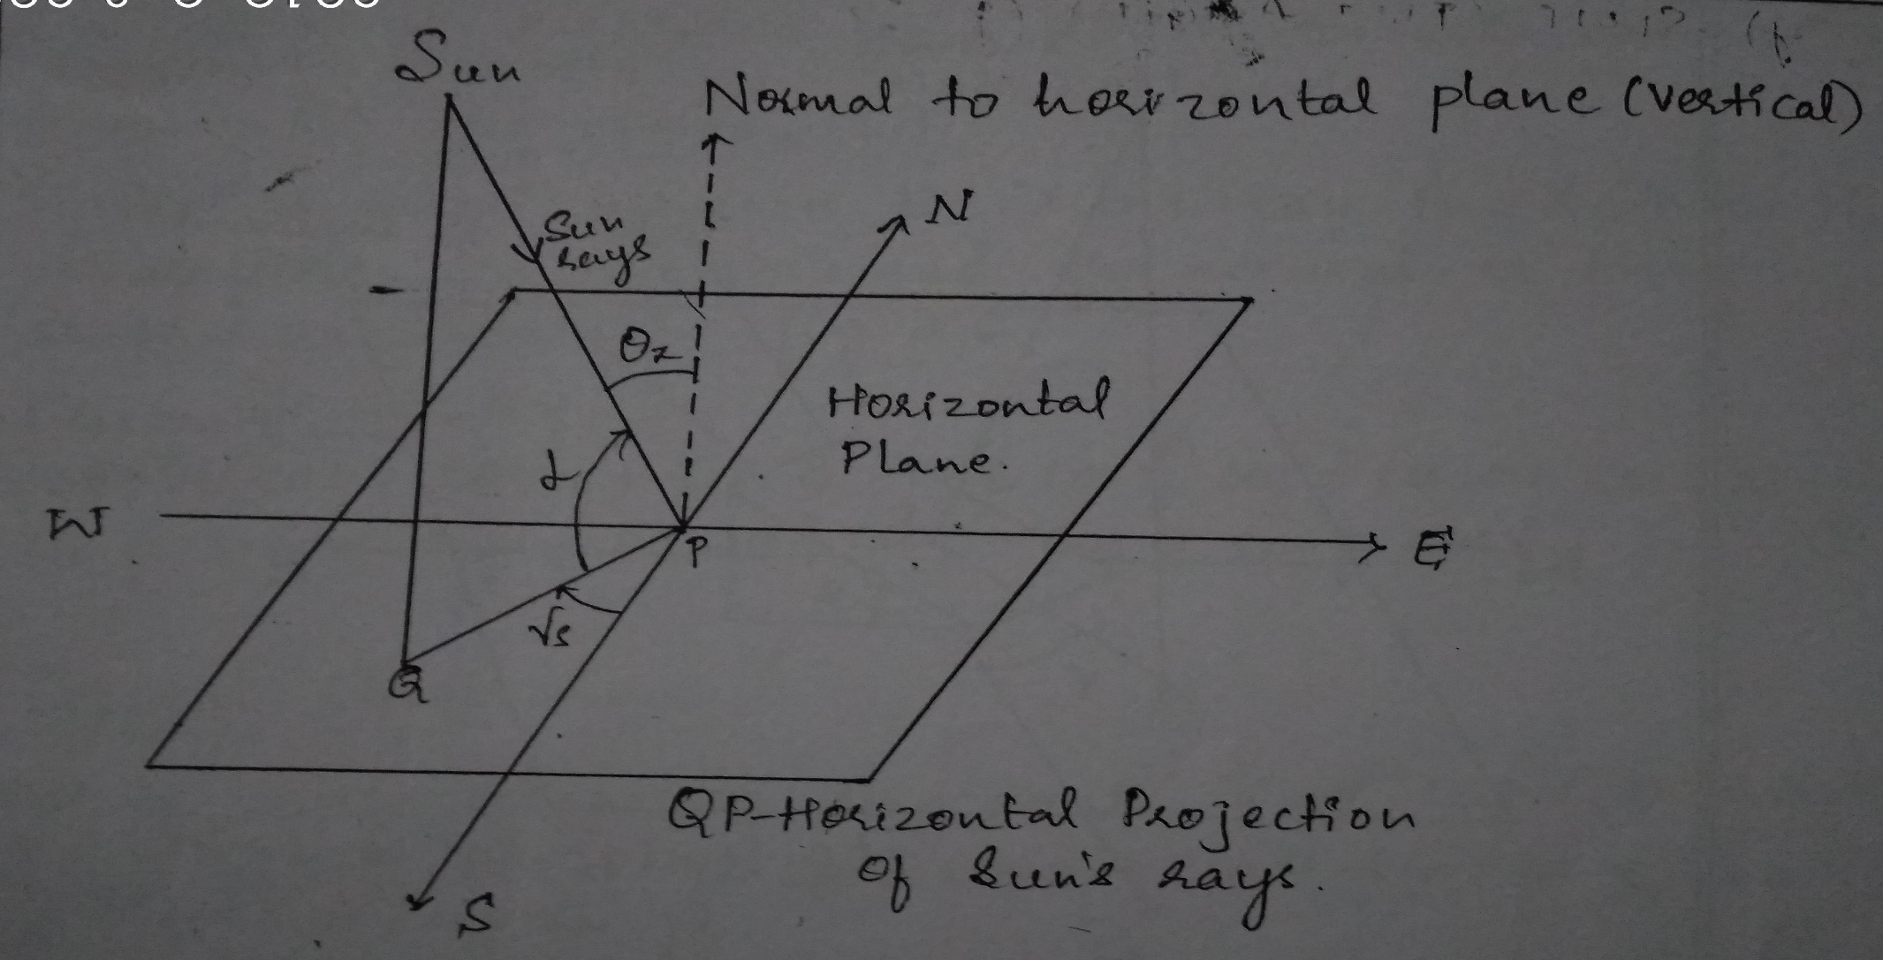
Inclination Angle (ALTITUDE) (α)
The angle between the sun’s ray and its projection on a horizontal surface is known as inclination angle.

Slide 21
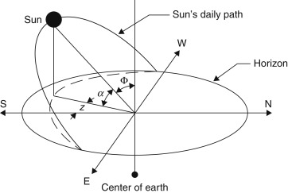
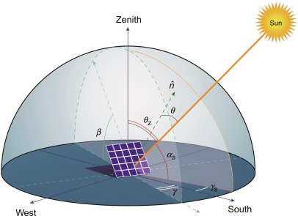

Slide 22
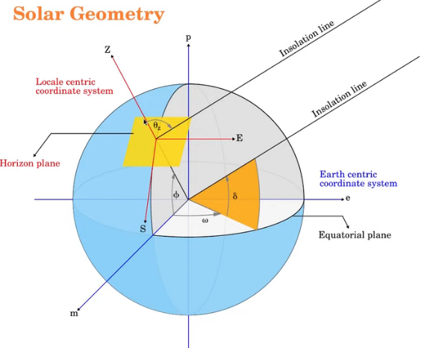
ZENITH ANGLE ($θ_{Z})$
it is the angle between the sun’s ray and perpendicular (normal) to the horizontal plane.

Slide 23
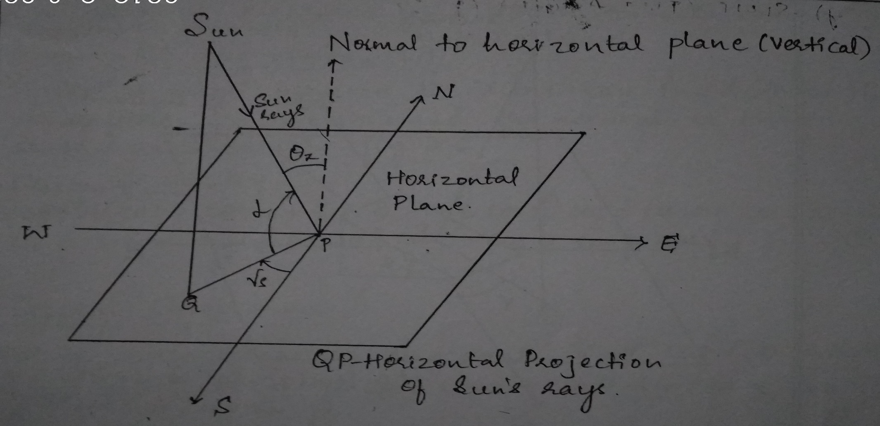
SOLAR AZIMUTH ANGLE ($γ_{s})$
It is the angle on a horizontal plane, between the line due south and the projection of sun’s ray on the horizontal plane.
It is taken as positive when measured from south towards west.

Slide 24
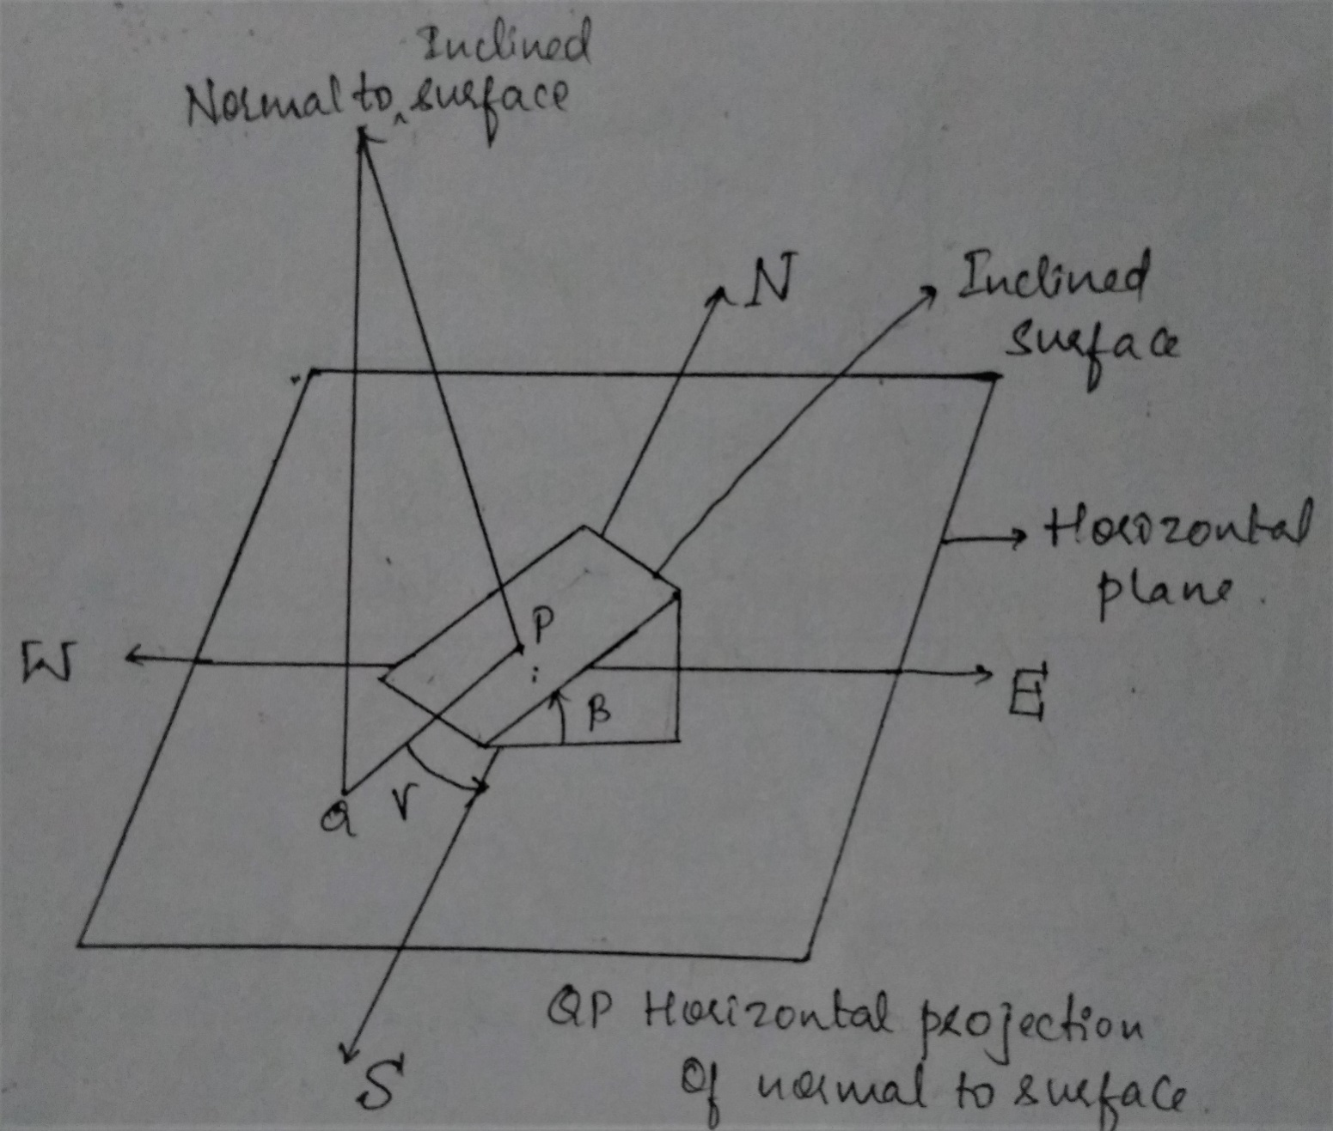
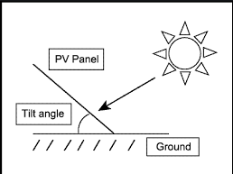
Slope (Tilt Angle) (β):
It is the angle between the inclined plane surface (collector) under consideration and the horizontal. It is taken to be positive for the surface sloping towards south.
Surface Azimuth Angle (γ)
It is the angle in the horizontal plane between the line due south and the horizontal projection of the normal to the inclined plane surface (collector).
It is the angle between the normal to the surface from true south,
It is taken as positive when measured from south towards west.

Slide 25
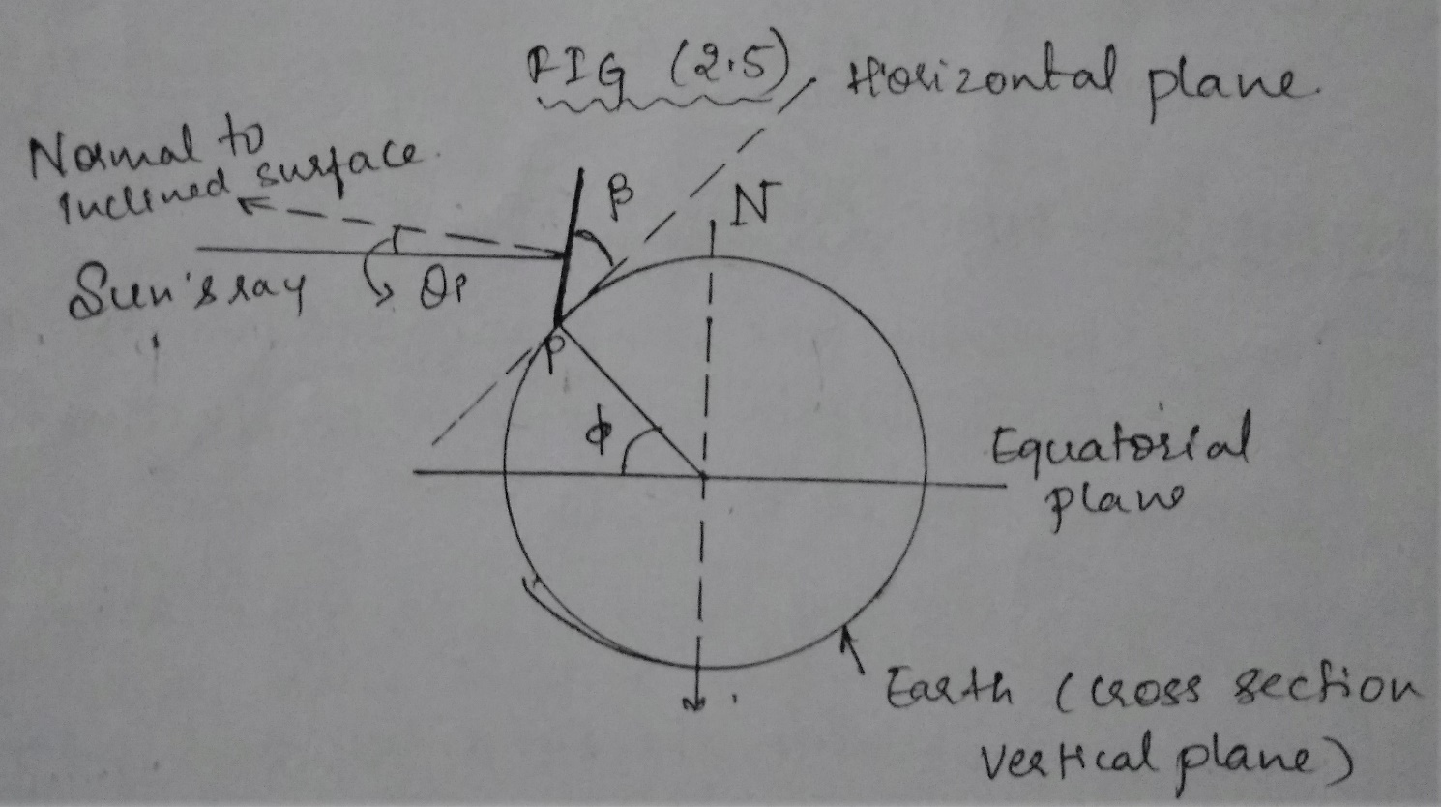
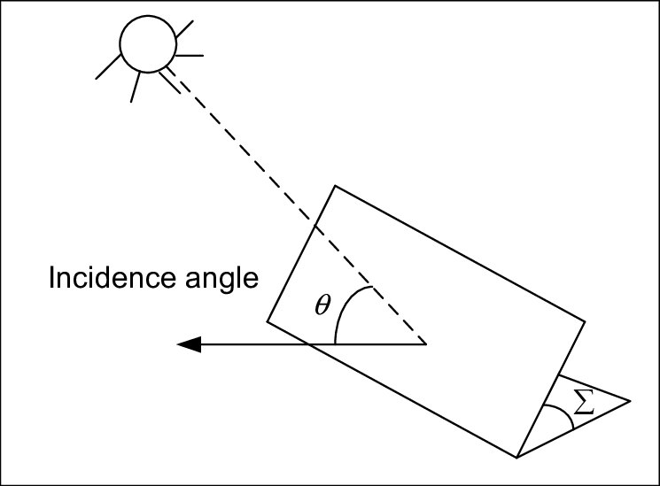
Angle of Incident ($θ_{i})$
It is the angle between the sun’s ray incident on the plane surface (collector) and the normal to that surface

Slide 26
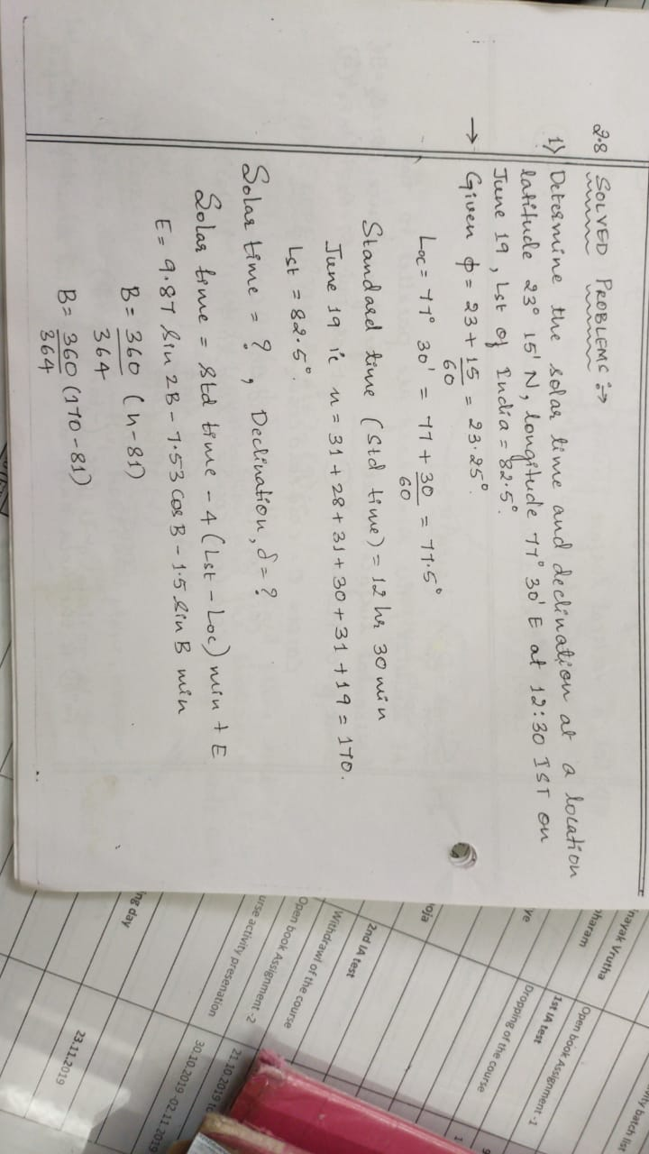

Slide 27
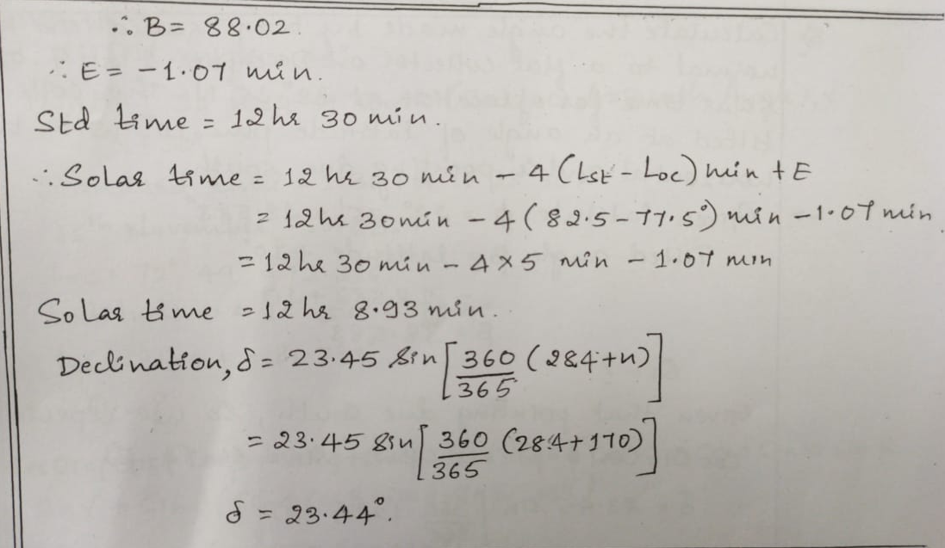

Slide 28
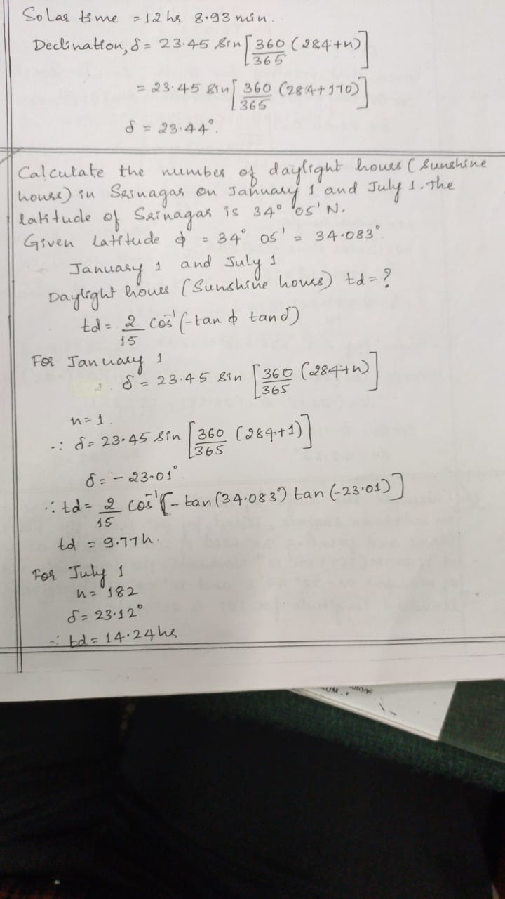

Slide 29
Measurements of Solar Radiations
Pyranometer:
It is designed to measure global radiation, usually on a horizontal surface, but can also be used on a inclined surface , when shaded from beam radiation by using a shading ring, a Pyranometer measures diffused radiation.
2. Pyrheliometer:
it measures beam radiation by using a long narrow tube to collect only beam radiation from the sun.
3. Sunshine Recorder:
It measures the sunshine hours in a day.

Slide 30
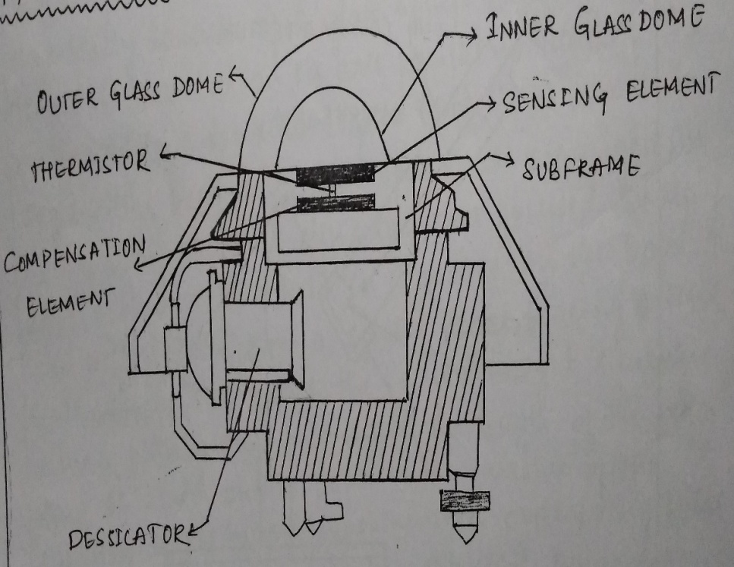
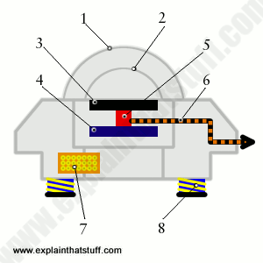
Pyranometer:
It is designed to respond to radiation of all wavelengths and hence measures accurately the total power in the incident spectrum.
It contains a thermopile whose sensitive surface consists of circular, blackened, hot junctions, exposed to the sun.
The cold junctions being completely shaded, the temperature difference between cold and hot junction is the function of radiation falling on the sensitive surface.
The sensing element is covered by two concentric hemispherical glass dome’s to shield it from wind and rain. This reduces the convection currents.
A radiation shield surrounding the outer dome and coplanar with the sensing element, prevents direct solar radiation from heating the base of the instrument.
The instrument has a base output voltage of 9μV/W/m² and has an output impedance of 650Ω.

Slide 31
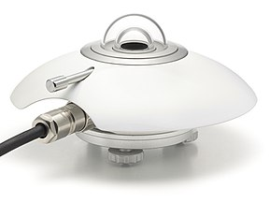

Slide 32
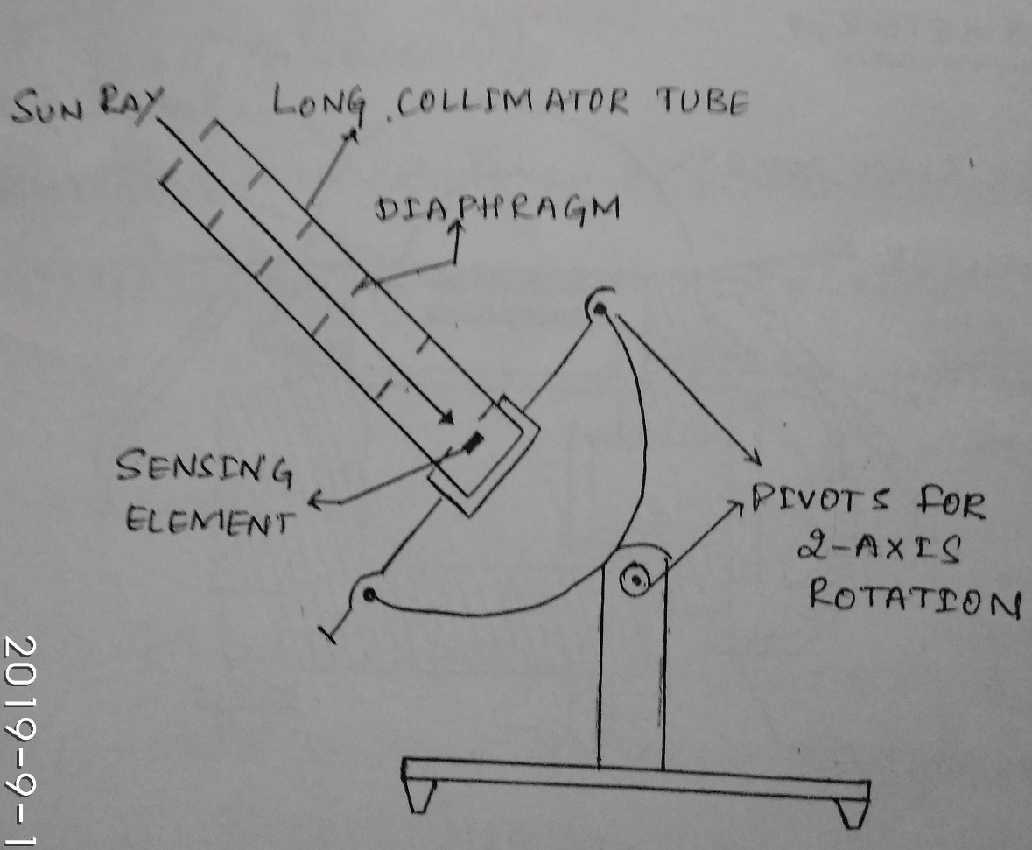
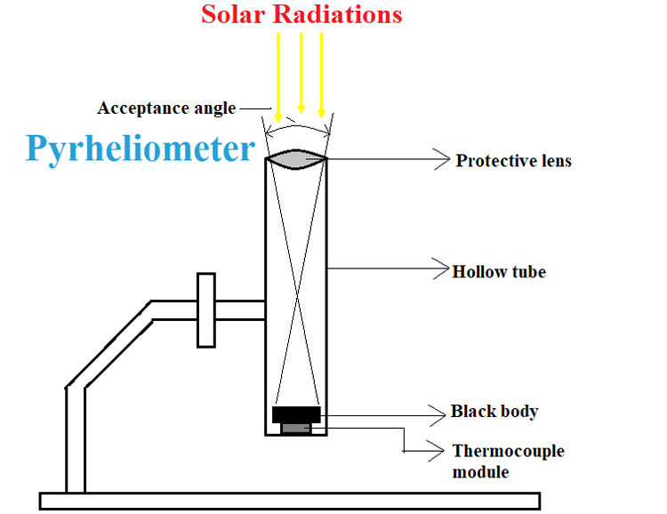
Pyrheliometer:
It uses long collimator tube to collect beam radiation whose field of view is limited to a solid angle of 5.5° by appropriate diaphragms inside the tube.
The inside of the tube is blackened to absorb any radiation incident at angles outside the collection solid angle.
At the base of the tube a wire wound thermopile having a sensitivity of approximately 8μV/W/m² and has an output impedance of 200Ω is provided.
The tube is sealed with dry air to eliminate absorption of beam radiation within the tube by water vapour.
A tracker is needed if continuous readings are desired.

Slide 33
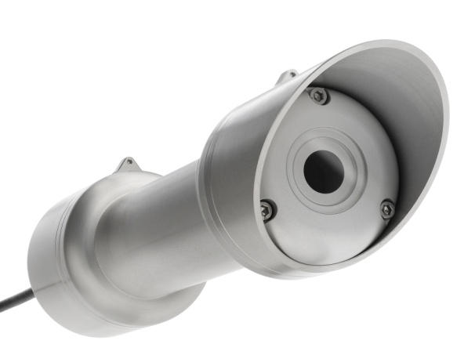
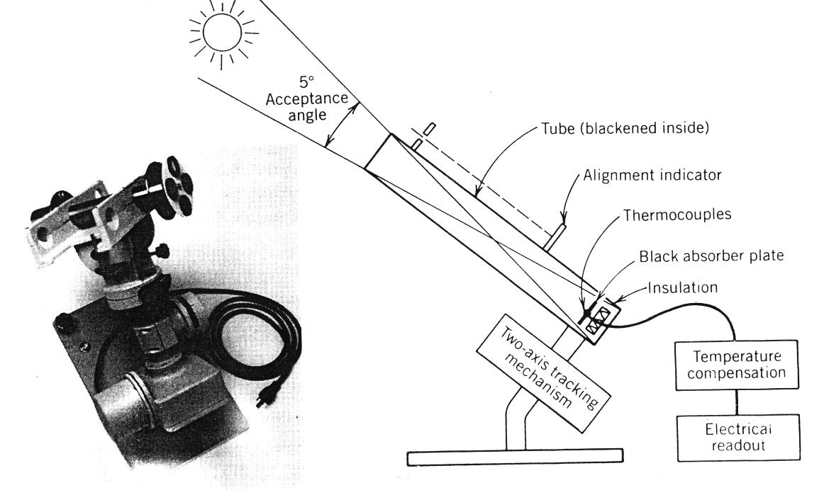
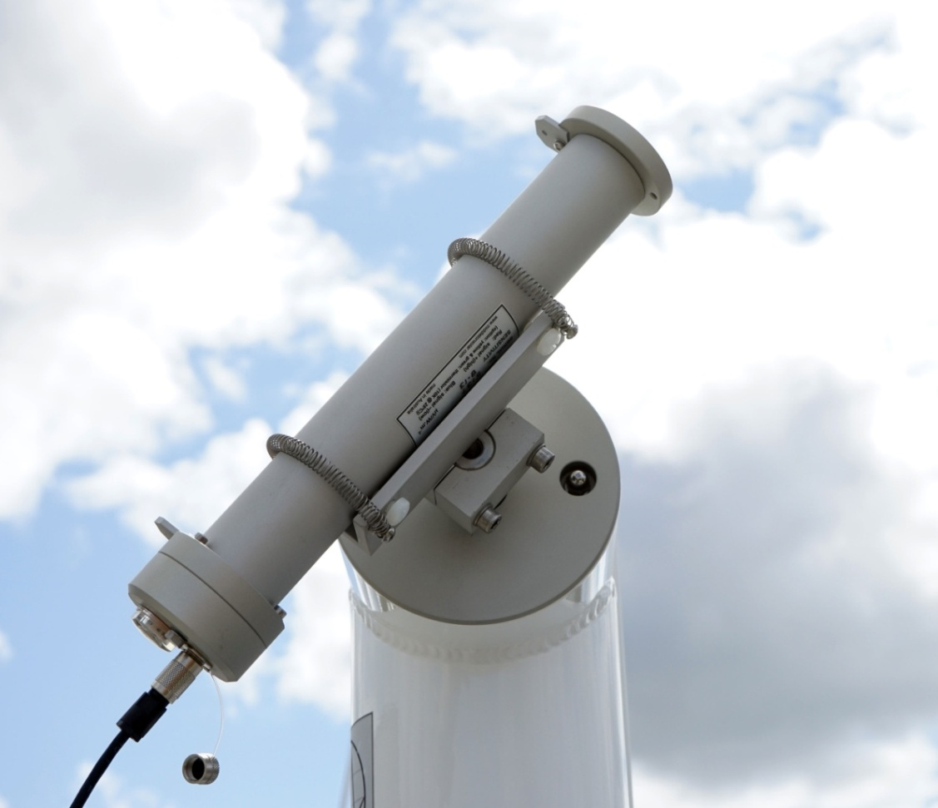

Slide 34
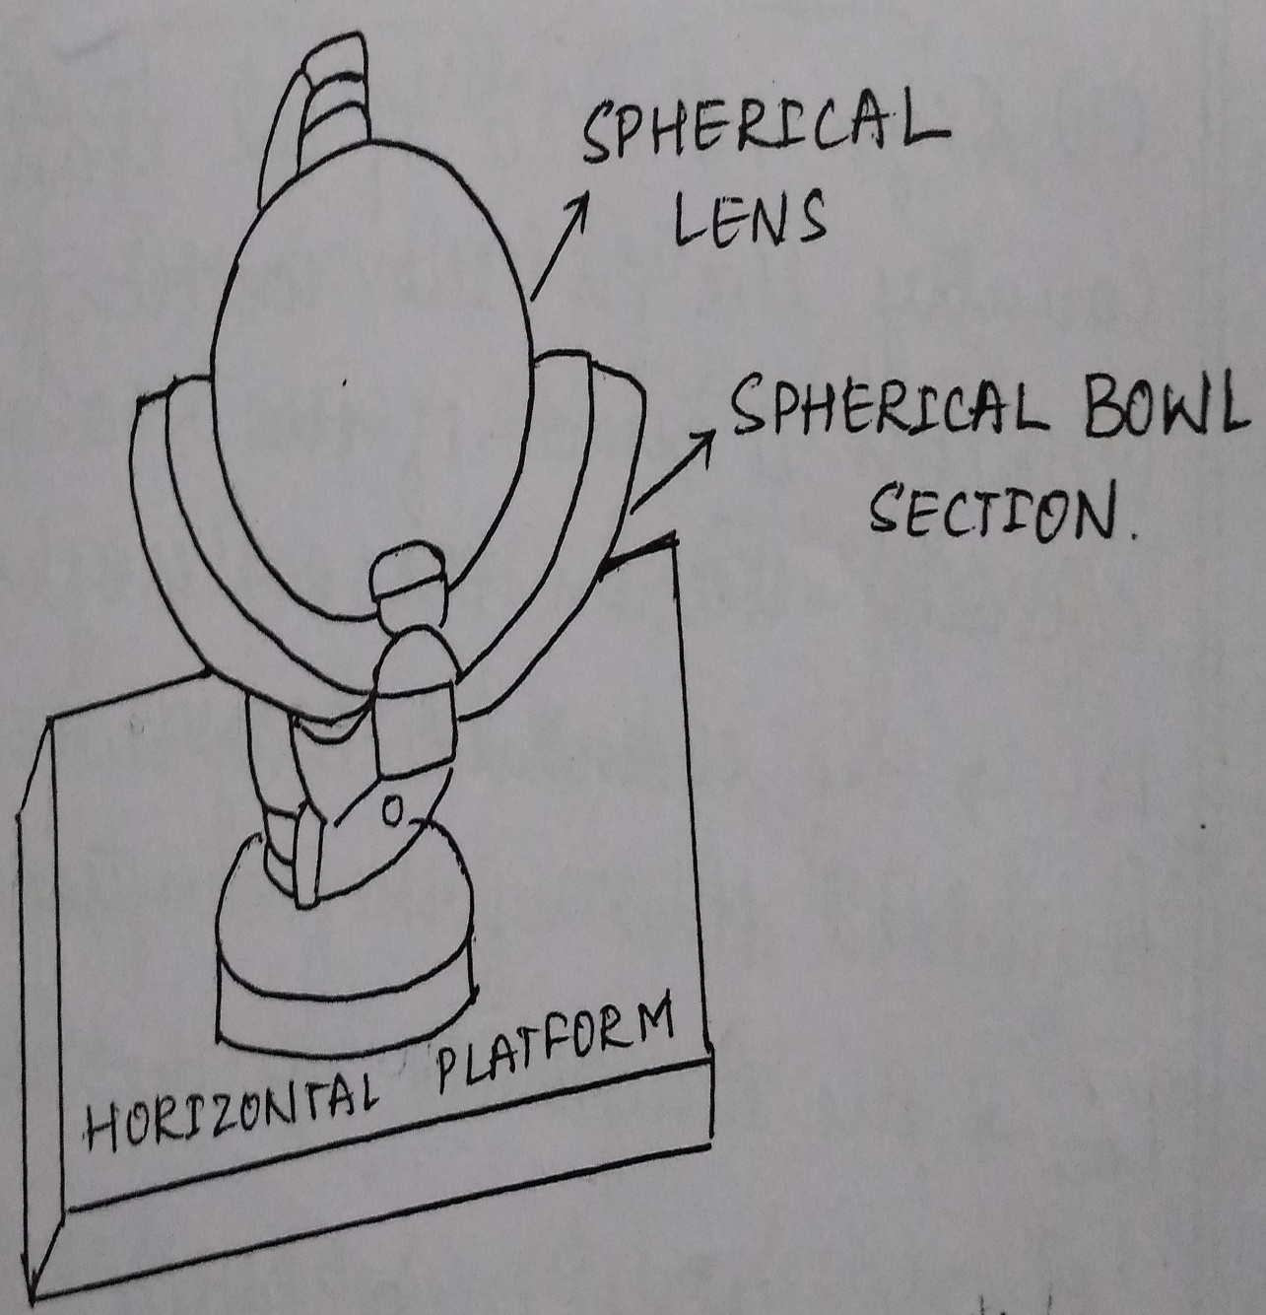
Sunshine Recorder:
This instrument measures the durations in hours of bright sunshine during the course of the day.
It consists of a glass sphere (about 10 cm in diameter) mounted on its axis parallel to that of the earth, within a spherical section (bowl).
The bowl and glass sphere are arranged in such a way that the sun’s rays are focused sharply at a spot on a card held in a groove in the bowl.
The card is prepared from a special paper bearing a time scale.
As the sun moves, the focused bright sunshine burns a path along this paper.
The length of the trace thus obtained on the paper is the measure of the duration of the bright sunshine.
Three overlapping pairs of grooves are provided in the spherical segment to take care of the different seasons of the year.

Slide 35
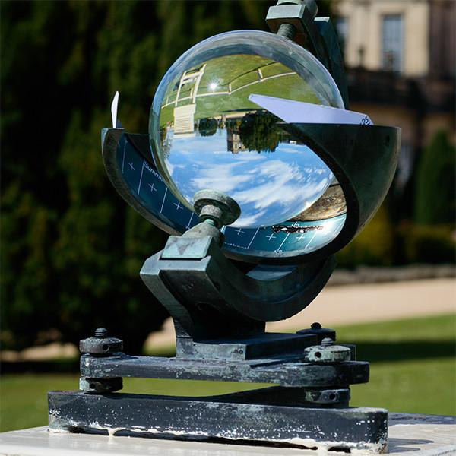
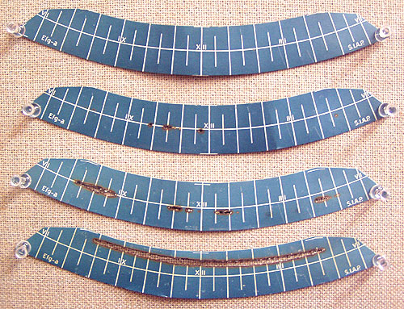
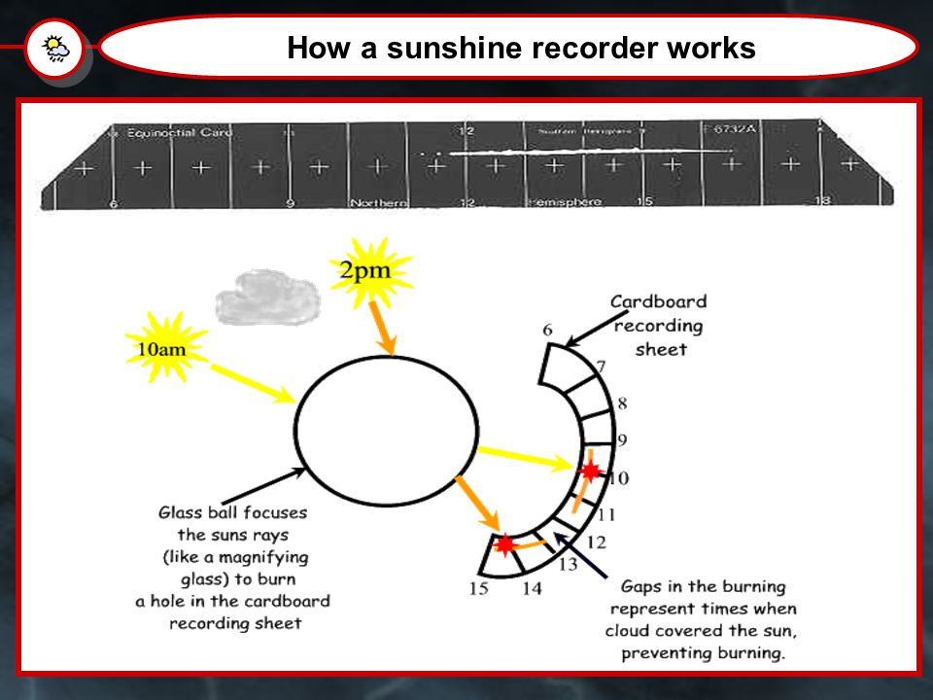

Slide 36

Choose smart energy, Choose clean energy
Thank You

